Slide 1
Knowledge Management
UE17CS342
Project Title : Knowledge Management System at Coca-Cola
Project Guide : Prof. Krupesha
Project Team : Vidhaan Mishra PES1201700055
Phalguni Kamani PES1201700759
Pushpender Singh PES1201700243

Slide 2
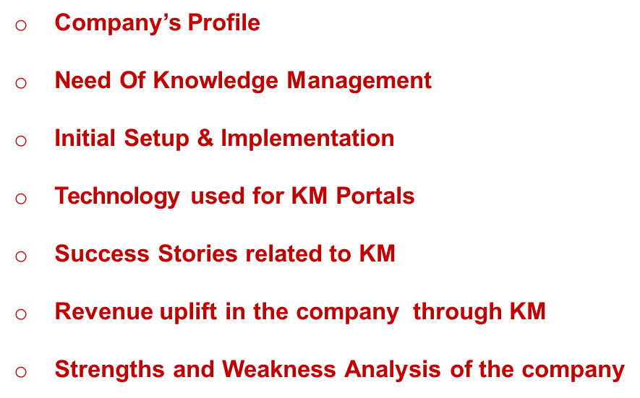
OBJECTIVES

Slide 3
About the Company
Type | Soft Drink (Cola)
Manufacturer | The Coca- Cola Company
Founder (s) | John S. Pemberton
Country of Origin | United States
Introduced | 1886
Area Served | Over 200 countries
Flavors | Cola, Cola Green Tea, Cola Lemon, Cola Lemon Lime, Cola Lime, Cola Orange and Cola Raspberry.
Employees | 92,400
Servings per Day | 1.6 Billion

Slide 4
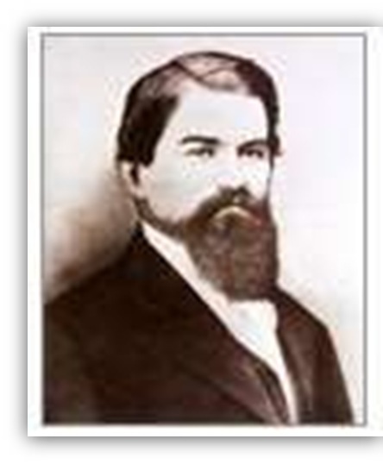
COMPANY OVERVIEW
The Coca-Cola Company was originally established as the J. S. Pemberton Medicine Company, a co- partnership between Dr. John Stith Pemberton and Ed Holland.
Dr. John Stith Pemberton for the first time
produced the syrup for Coca-Cola on May 8, 1886.
The company was formed to sell three main products:
Pemberton's French Wine of Cola
Pemberton's Indian Queen Hair Dye
Pemberton's Globe Flower Cough Syrup.

Slide 5

COMPANY OVERVIEW
The Coca-Cola Company is the world's largest beverage company.
Largest manufacturer, distributor and marketer of non- alcoholic beverage concentrates and syrups in the world.
Interbrand’s Global Brand Scorecard for 2003.
Ranked Coca-Cola the #1 Brand in the World and estimated
its brand value at $70.45 billion

Slide 6
VISION
People: Be a great place to work where people are inspired to be the best they can be.
Portfolio: Bring to the world a portfolio of quality beverage brands
that anticipate and satisfy people's desires and needs.
Partners: Nurture a winning network of customers and suppliers, together we create mutual, enduring value.
Planet: Be a responsible citizen that makes a difference by helping
build and support sustainable communities.
Profit: Maximize long-term return to shareowners while being mindful of our overall responsibilities
Productivity: Be a highly effective, lean and fast-moving organization.

Slide 7
MISSION
To refresh the world in body, mind and spirit
To inspire moments of optimism through our brands and our actions
To create value and make a difference everywhere we engage.
Leadership: The courage to shape a better future
Integrity: Be real
Accountability: If it is to be, it's up to me
Passion: Committed in heart and mind
Diversity: As inclusive as our brands
Quality: What we do, we do well

Slide 8
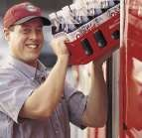


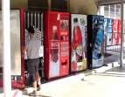
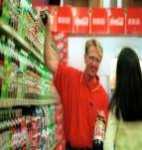

CUSTOMER SERVICE OVERVIEW
Product
Service Support
Distribution
Call Types
CSR
Customer or Consumer
Repair
Customer Support

Slide 9
NEED OF KM
The only way for employers to get to each of their performances is an improved technology in delivering to them proper knowledge management.
Create the need for them to rely on the system so the industry attains an increase in profit and production.
It provides employers and business owners to widen their understanding when it comes to managing their employees.
It does not only mean the mere understanding of what they have to do for the company but it’s more about providing them with the proper technology and help them enhance skills and become more of an asset to the company than a liability.

Slide 10
INITIAL SETUP OF KM
The company management has developed processes and structures
which have enabled this effective performance.
One key element of success is decentralization, which creates an environment where managers are given responsibility and are results driven.
The policy of appointing local management wherever possible also
helps the company best adapt to local conditions.
At the basis of this decentralized structure, there is the principle that
the people closer to the problem are closer to the solution.
The strength of a multinational company over a smaller company is the knowledge each part of the business has developed over time, which can be used by others in the organization.
There are few formal mechanisms for knowledge management.
The main tools used at coca cola are the intranet, the appraisal
meetings/business reviews, and informal networks.

Slide 11
INITIAL SETUP OF KM (contd…)
It is understood that every framework developed by the company began as a thought in the minds of the employees.
Thus, the Coca Cola Company had flourished into a multinational corporation because of the tacit knowledge of the employees.
The knowledge management of Coca Cola has a deep relationship
with collaboration.
It partake the nature of not just a system but a huge network where the people within the company can communicate with the company network based in a different country.

Slide 12
INITIAL SETUP OF KM (contd…)
o This nature will help assess knowledge managers on how much information must the company need to further their endeavors of perfection and customer satisfaction.
o In executing their strategy, knowledge management is very useful because it serves as a pattern or guide where certain areas are marked as they deemed fit, or areas are being highlighted which they saw that needs for further improvement.
o It also serves as a strong pivotal point where company seeks assessment or gathers information to further expand the Coca Cola System.

Slide 13
IMPLEMENTATION OF KM
Tacit knowledge among employees has helped the company create innovations in their products.
All it takes is to exhaust ideas and knowledge within the workplace.
In order that this knowledge may be properly organized and put into concepts, a good inter-personal relationship is essential that the tacit knowledge may be well put into conception.
Output of which would very much depend on the needs of the employees which means that the decisions are for them to make on what technology to use.
The strategy applied by the company is based from value chains
and force models.
These tools have helped the company maximize and guide them in their efforts to resolved future business reverses. And it is definitely very effective as the world has undergone a recession; the Coca Cola Company has stood still and still braving its way towards success and perfection.

Slide 14
INTERNAL ANALYSIS OF KM
It is strongly suggested to take credit on every reviews being put under the company .
This must not be taken for granted, but instead be recorded on the company database for future reference or as a guide to help develop a system to improve and at the same time would attend to the needs of the customers.
The company is quite sensitive to culture and reputation both of the supplier and customer because of their pursuit of bringing brighter and better innovation to the public consumer.
They also believe that feedbacks are created to meet the demands
and needs of the customers.

Slide 15
ACCOUNTING SYSTEM OF THE COMPANY
o There are three types of bottling relationships at Coca Cola:
Bottlers that the company has no ownership interest;
Bottlers that the company has a controlling ownership interest;
Bottlers that the company has non-controlling ownership interest.
Bottling partners are authorized to manufacture and package products.
Being able to manufacture primarily is advantageous in the company’s part in acquiring controlling interest in a bottling operation.
By owning the controlling interest, the company helps in the improvement of their information system.
This is when the accounting system and the need for such
technology arise.
The intranet system as part of the knowledge management guides very well the information system needed for accounting
(The Coca Cola Company, 2006).

Slide 16
TECHNOLOGY USED
The intranet system is the use of latest technology into the company.
The employees are helped not only in honing their skills but also helped the company improve better communication among bottling partners and the company itself.
This intranet strategy will help improve the relationship of the
bottlers because of the network created between them.
Knowledge management will provide them with facts and points on how greatly serve customer satisfaction.
The bottlers are they key source from which knowledge management can acquire data, since the bottlers know the community very much and they are considered as the basic unit of the whole Coca Cola System (1999).

Slide 17
TECHNOLOGY USED contd
The future of Coca Cola’s success lies on improving their information technology.
Through the advance Electronic Data Interchange (EDI) technologies which are implemented into the company's information system, the employees can easily access to the operational information, such as consumer information, sales, and promotions.
This enhances the employees‘ knowledge and increases their responsiveness to the customers.
This type of advanced enterprise content management technology enables corporations to repurpose valuable assets, as well as improve efficiency, speed, continuity and collaboration in a way that gives them a competitive advantage.
o To deliver an integrated digital library, Coca-Cola created an easy-to- use user interface that is sophisticated enough to communicate with The Coca-Cola Company's various servers, databases, and existing archives.
They also can separate the actual object from the important metadata attached to it.

Slide 18
SUCCESS STORY OF COCA-COLA KM
The Coca-Cola Company and IBM Create Unique Digital Media Management System
IBM and The Coca-Cola Company announced that Coca-Cola is leveraging IBM's most advanced digital asset management technology to create a powerful resource for managing archival information.
The new Coca-Cola digital media system makes a century's worth of corporate marketing and advertising icons available at the desktop through a worldwide internal network, allowing Coca-Cola employees to more easily access and use the material for future projects.
This new system combines distinct libraries of text, still images and video to build an integrated digital archival library, which is then made available as a business tool to Coca-Cola associates in more than 200 countries.

Slide 19
SUCCESS STORY OF COCA-COLA KM
The new digital management system currently includes tens of thousands of video clips, photographs, and many of The Coca-Cola Company's most famous marketing and advertising icons.
The Coca-Cola digital archives are built on a foundation of IBM's
Content Manager, Lotus Notes and Lotus Domino software.

Slide 20
SUCCESS STORY OF COCA-COLA KM
HOW IT WORKS –
For example, if a Coca-Cola advertising team is working on a new "holiday'' campaign, a team member can search the Digital Archives for "holiday'' or "Christmas'' or "Santa Claus'' ads, and pull up the entire spectrum of print and video advertisements created on the subject.
The team member can search for many topics across different types of data sources simultaneously through a specific keyword, a year, a brand, an image, or even a specific string of text.
"More Than A Retrieval System''
"It is one of the first corporations to move an entire advertising and brand history to an online Digital Media environment,'' said Dick Anderson, general manager, Digital Media Solutions, IBM.
The growth of e-business is increasing the need for companies to manage and distribute digital content, including images, computer-generated output, business documents, and rich media.

Slide 21
SUCCESS STORY OF COCA-COLA KM
"More Than A Retrieval System'' Contd…
The growth of e-business is increasing the need for companies to manage and distribute digital content, including images, computer-generated output, business documents, and rich media.
In fact, studies show that;
More than 85% of today's business information resides in sources beyond traditional databases.
Less than 5% of that content is digitized.

Slide 22
SUCCESS STORY OF COCA-COLA KM
In fact, studies show that;
More than 85% of today's business information resides in sources beyond traditional databases.
Less than 5% of that content is digitized.

Slide 23
REVENUE UPLIFT THROUGH KM
Financial Condition Analysis According to Jain (2004), a business expert, the Coca-Cola Enterprises experienced their first annual profit since 1991.
Their profit was 3.03€ million compared to a loss of 12.11€ million in 1994. Their three years of losses totaled over 151.37€ million with their largest in 1993 at 105.2€ million.
Coca-Cola's sales volume increased for the second consecutive year with an 8% increase over 1994 totaling 176.19€ million. Their stock price nearly doubled over the previous year with a closing market price of 3.25€ in 1994 and a closing market price of 6.43€ in 1995.
The earnings per share for 1995 were 0.01 per common share compared to a net loss of 0.36€ in 1994.

Slide 24
REVENUE UPLIFT THROUGH KM
O Throughout 1995 Coca-Cola also embarked upon and continued various programs to cut costs and increase revenues. The company succeeded by decreasing their Operating expanses by 4% in 1995.
o Operating income was double 1994's at 45.64€ million and a 6.81€ million decrease was achieved in Selling, General and Administrative expenses.

Slide 25
REVENUE UPLIFT THROUGH KM
o Conclusions and Recommendations Through 1995, the company developed a multi-year initiative, Project MAX, that pursues superior customer responsiveness, quality and efficiency altogether.
o The company is focused on flexibility, reliability, quality and costs. Its task is to increase the responsiveness of the customers' needs, while producing the highest quality products at the lowest cost.

Slide 26
SWOT ANALYSIS Strengths
1. Dominant market share in the beverage industry
2. Diversified product portfolio with 21 billion-dollar brand
3. Company Valuation
4. Vast Global Presence
5. Brand Equity
6. Customer Loyalty

Slide 27
SWOT ANALYSIS Weakness
1. Competition with Pepsi
2. Product Diversification is low
3. Absence in health beverages
4. Water management
5. Business Reviews

Slide 28
SWOT ANALYSIS Opportunities
1. Diversification
2. Developing nations
3. Packaged drinking water
4. Supply chain improvement
5. Market the lesser selling products

Slide 29
SWOT ANALYSIS Threats
1.Raw material sourcing
2.Packaging controversy
3.Direct and indirect competition

Slide 30
Thank You

